Slide 1
IRIDOLOGY
ACCOMPANYING SLIDES

Slide 2
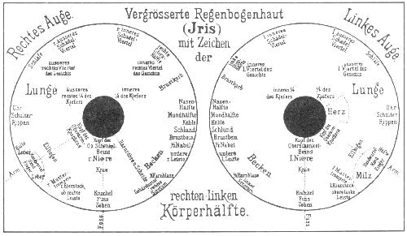
1: Ignatz Von Peczely Early iris map

Slide 3
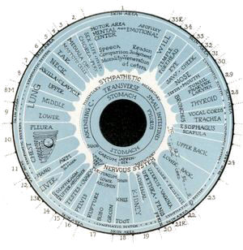
2: Henry Lindlahr Right Iris Map

Slide 4
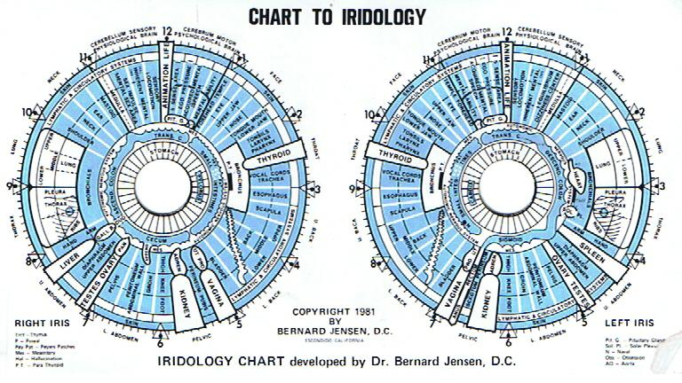
3:Bernard Jensen Iris chart

Slide 5
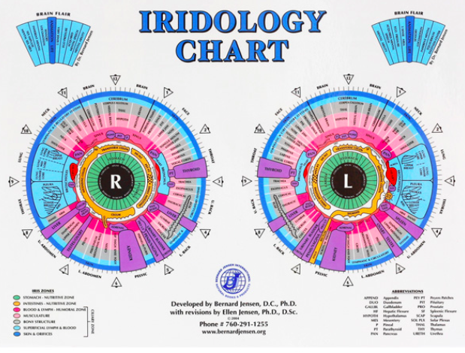
4: Revised Jenson Iris Chart

Slide 6
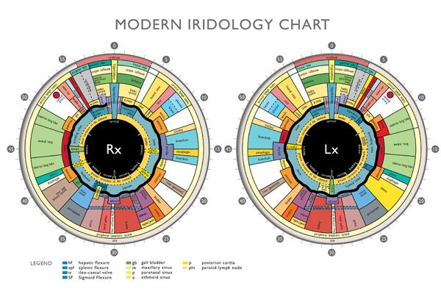
5: John Andrews Modern Iridology Iris chart

Slide 7
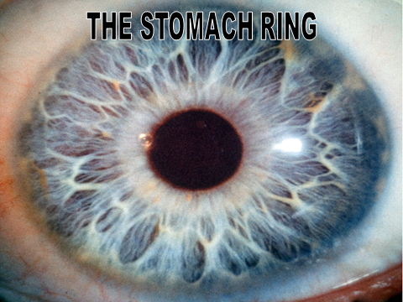

Slide 9
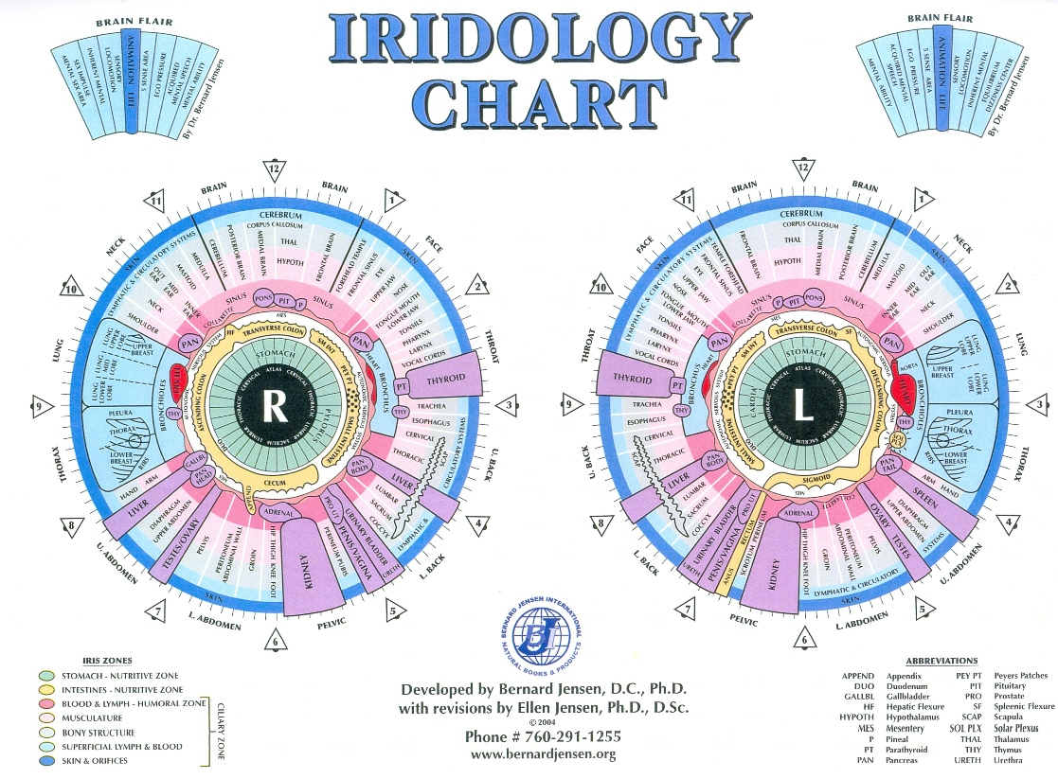
THE INTESTINAL RING
RIGHT IRIS
cecum
ascending colon
transverse colon
small intestines
LEFT IRIS
small intestines
transverse colon
descending colon
sigmoid
rectum
anus

Slide 10
Constricted Pupil

Slide 11
Contracted Pupil

Slide 12
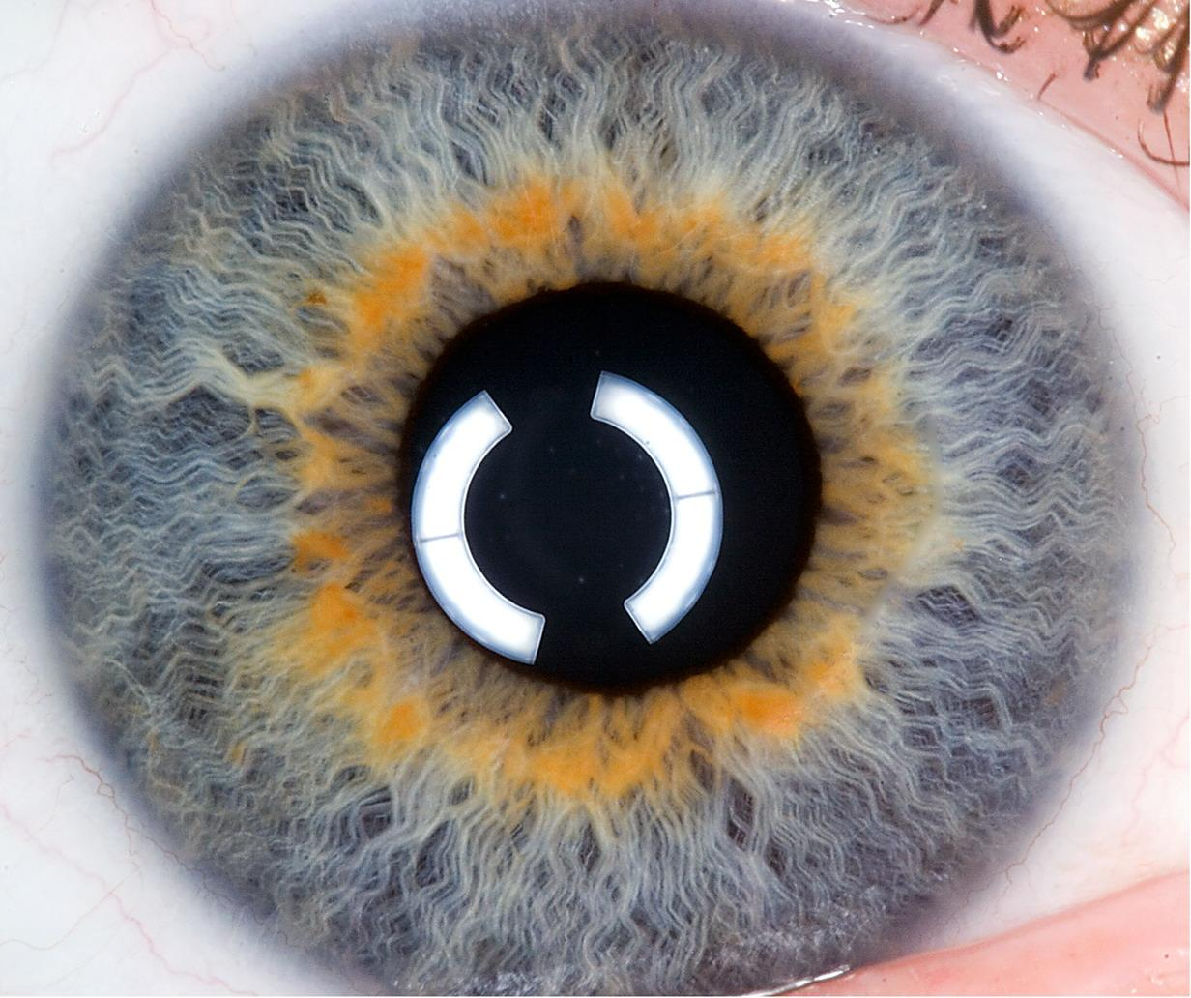
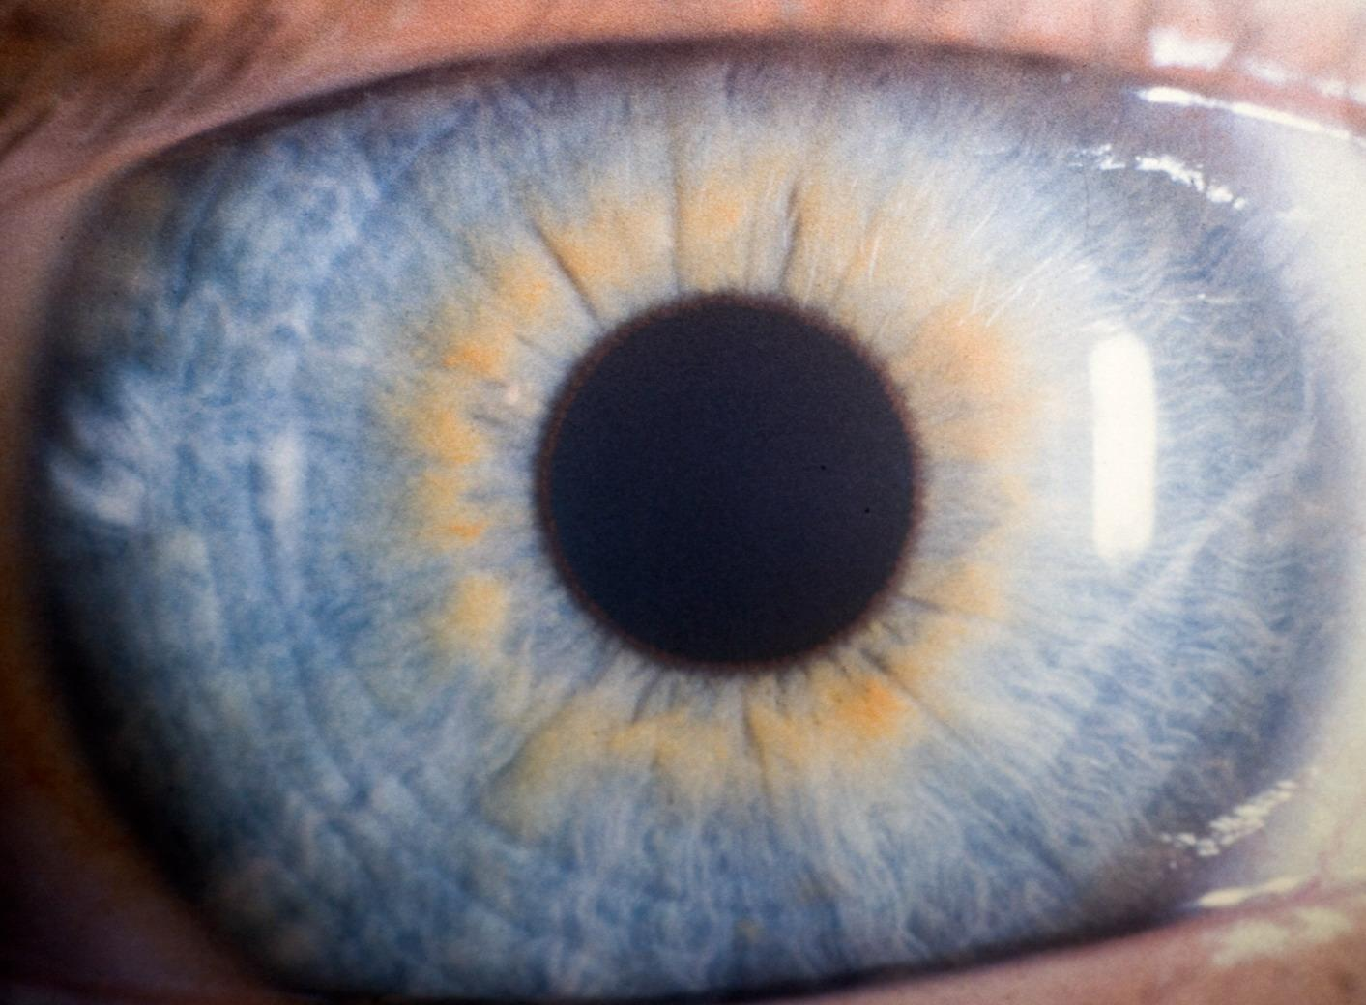

Slide 13
Grey ring around the pupil

Slide 14
Intestinal Ring Fibres

Slide 15
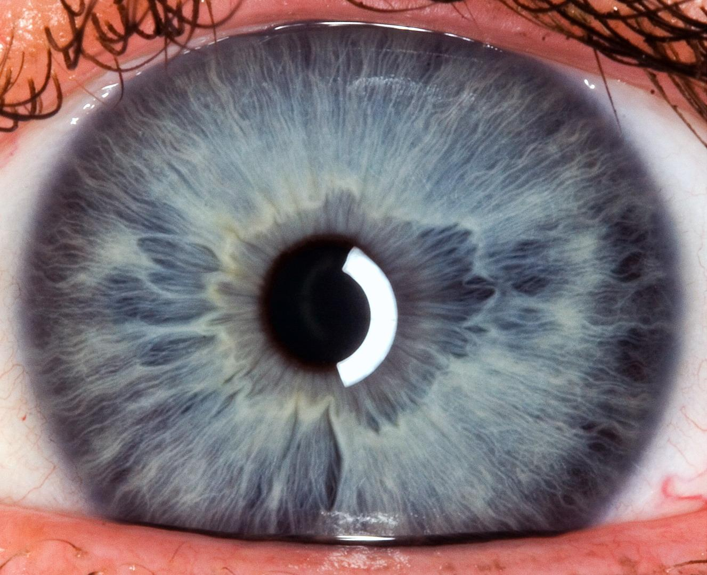
THE INTESTINAL RING
LEFT IRIS

Slide 16
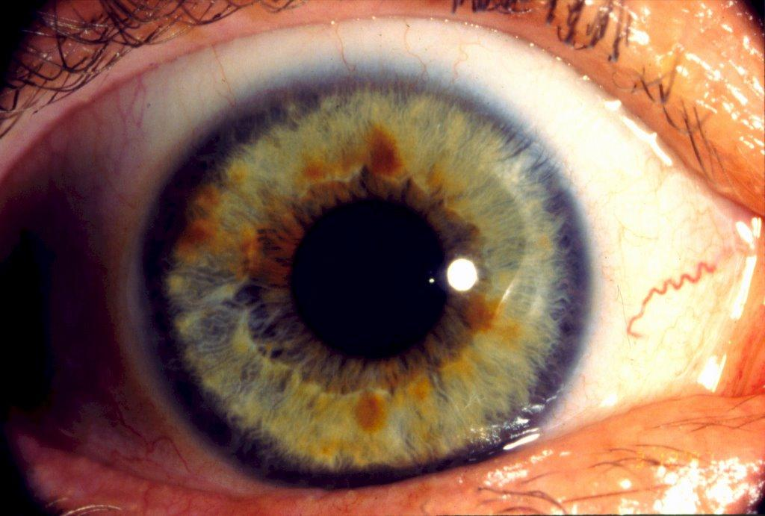
Scurf Rim

Slide 17
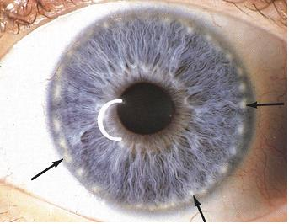
Lymphatic Rosary

Slide 18
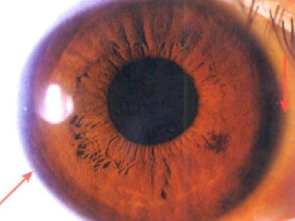
Circulatory ring or Venous ring

Slide 19
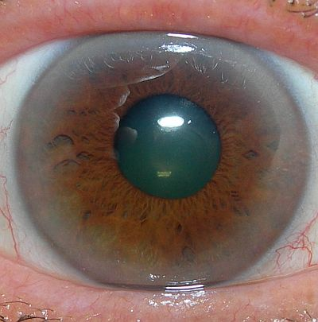
Cholesterol Ring

Slide 20
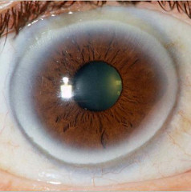
Sodium Ring

Slide 21
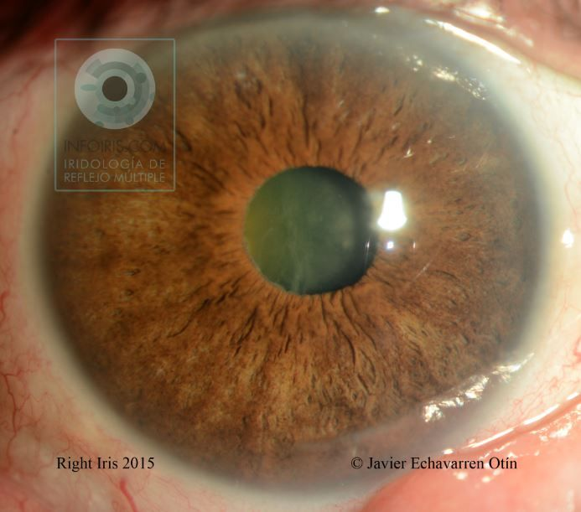
Arcus Senilis

Slide 22
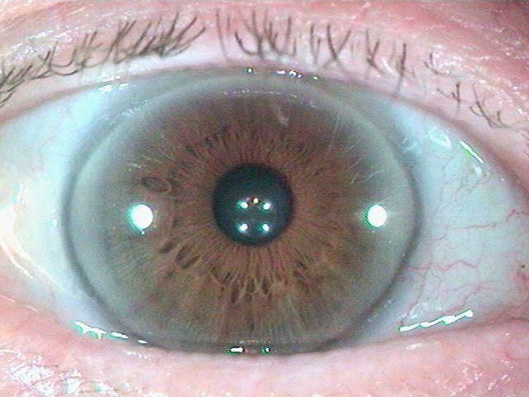
B 3 Bulge
A grey transparent curve extends outwards on both sides of the iris which changes the shape of the iris

Slide 23
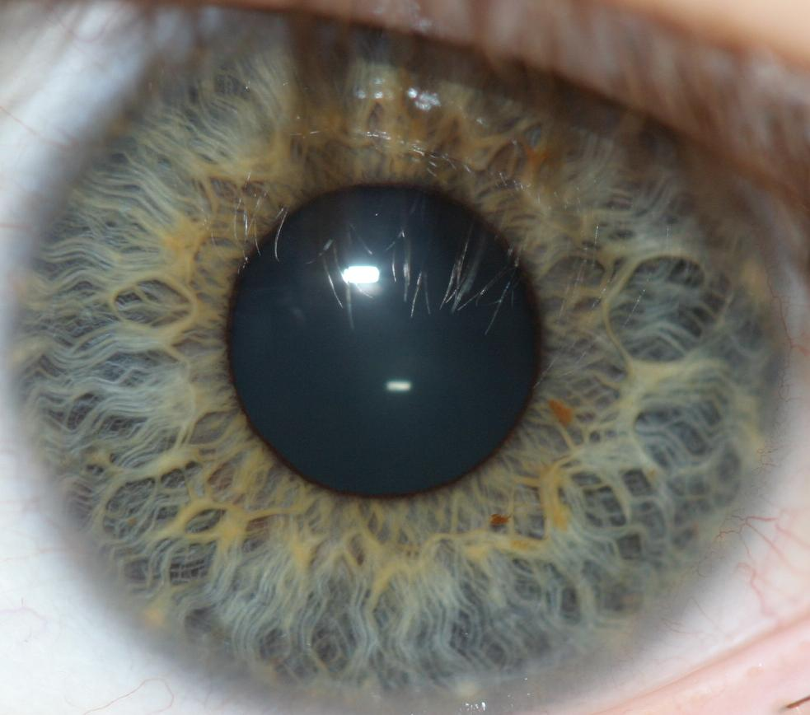
Medusa or Jellyfish Lacuna

Slide 24
2
1
American School of Iridology
Based upon the strength and density of fibres
3
6
4
5

Slide 25
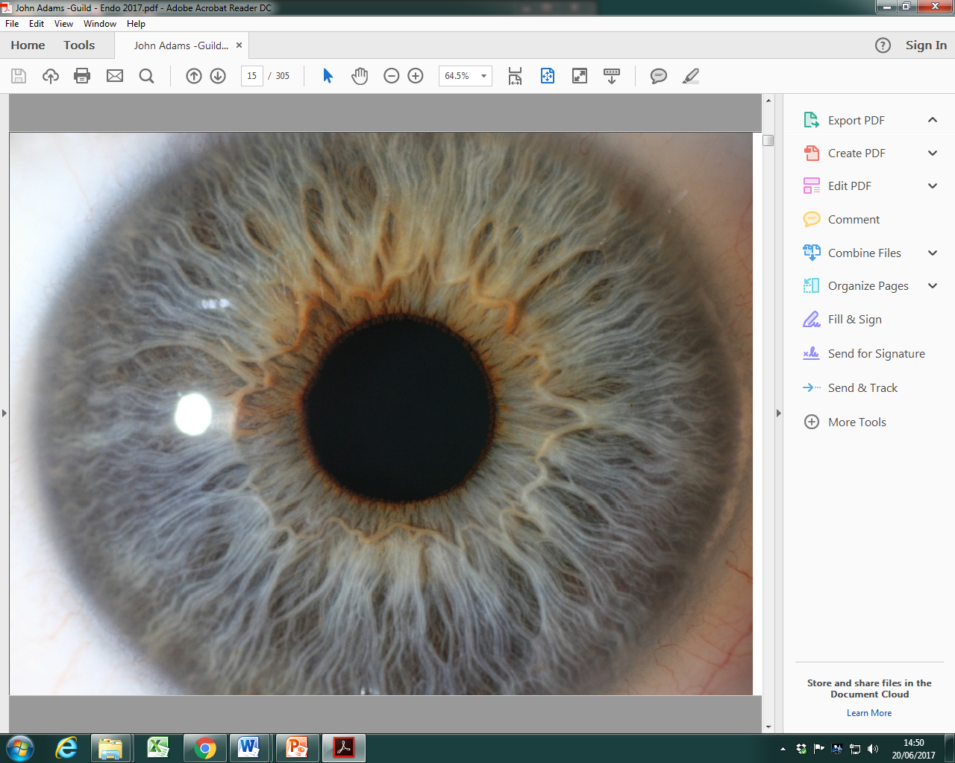
Open and Closed Lacuna
Open Lacuna
Closed Lacuna

Slide 26
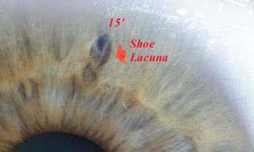
Shoe Lacuna

Slide 27
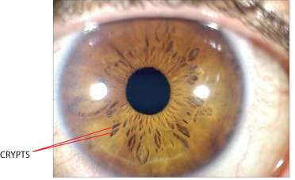
Crypts

Slide 28
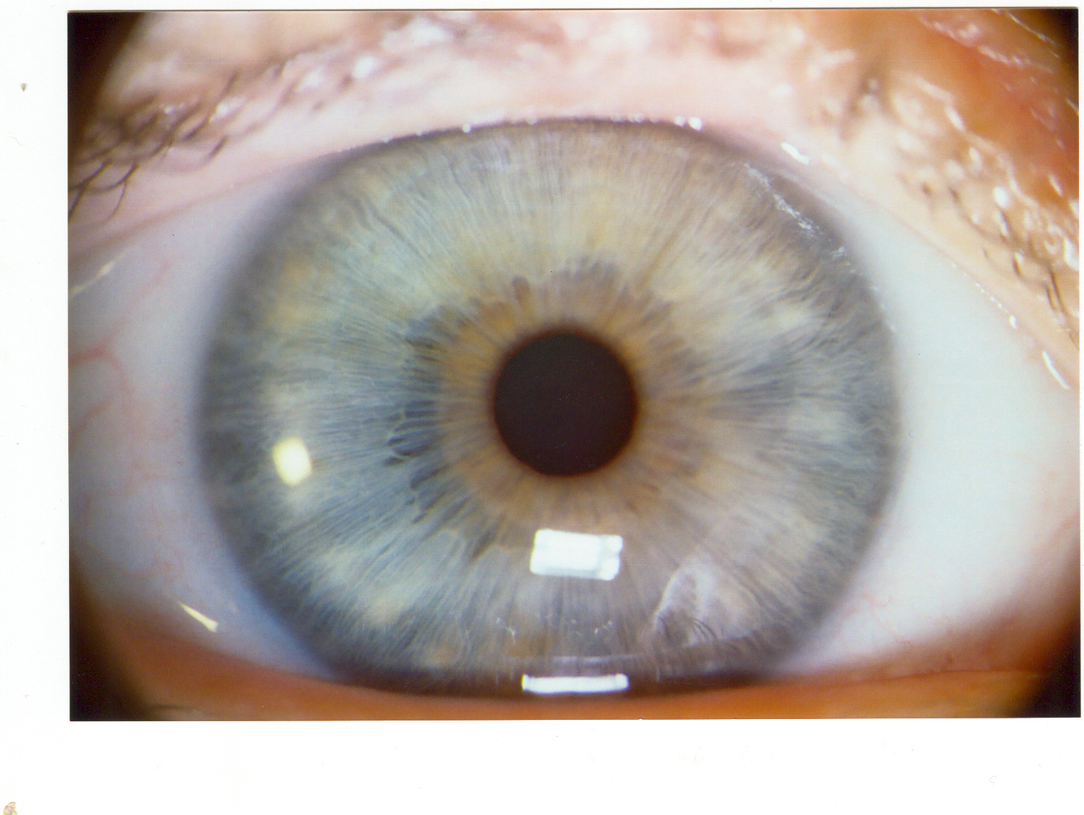
Plaques and Wisps

Slide 29
Central Heterochromia

Slide 30
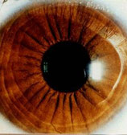
Radii Solares

Slide 31
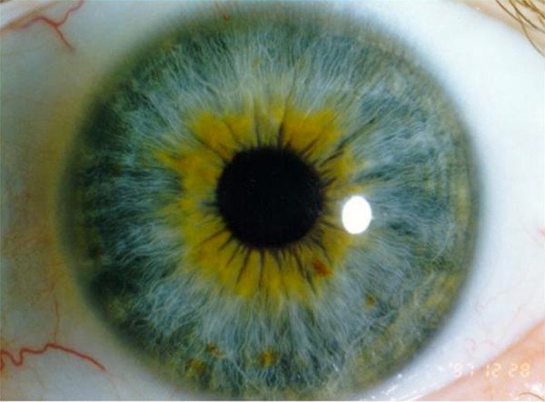
Transversal Fibres

Slide 32
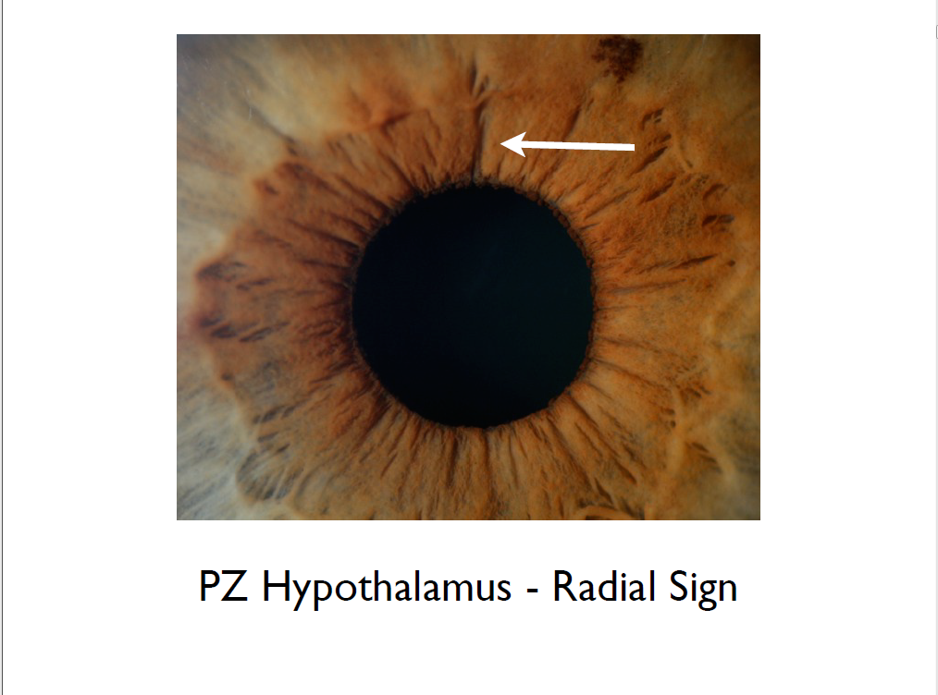

Slide 33
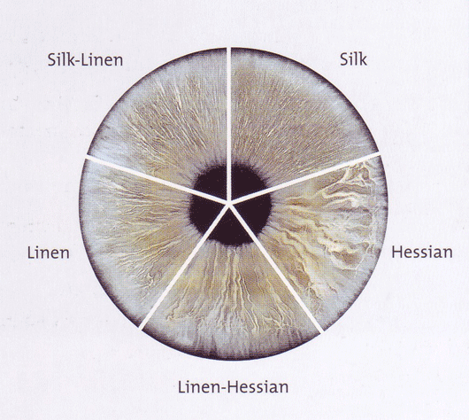
Dorothy Hall Constitutions

Slide 34
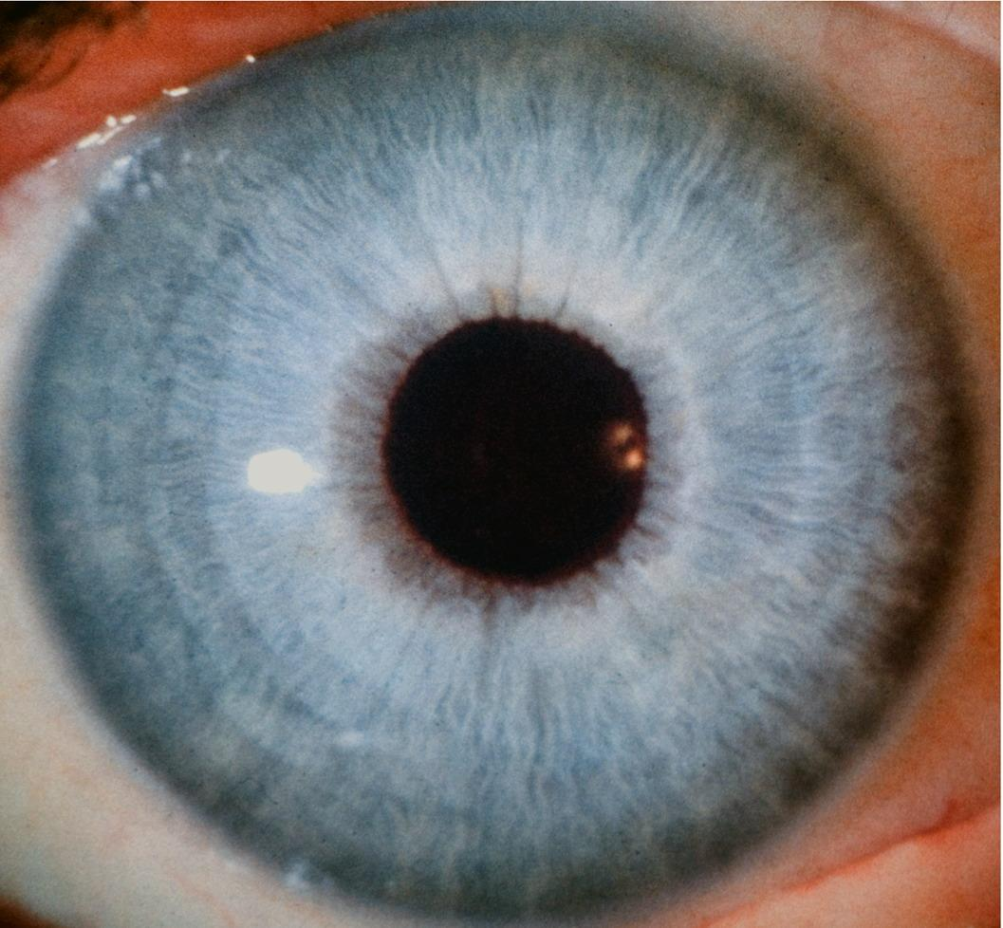
Silk Iris

Slide 35
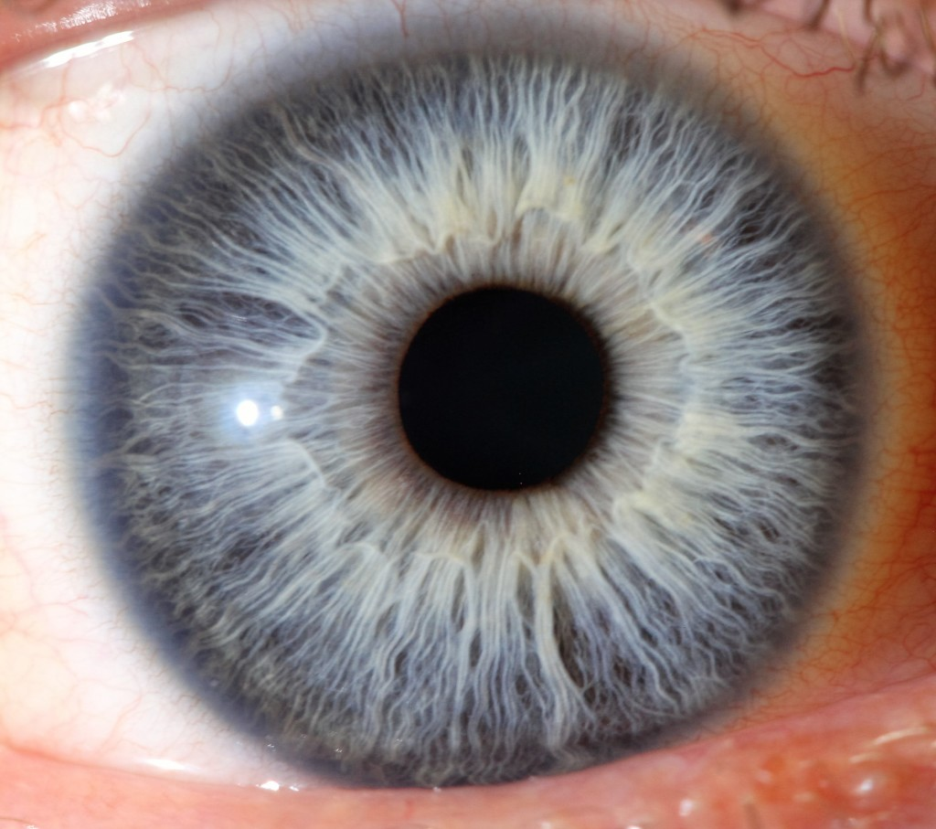
Silk Linen Iris

Slide 36
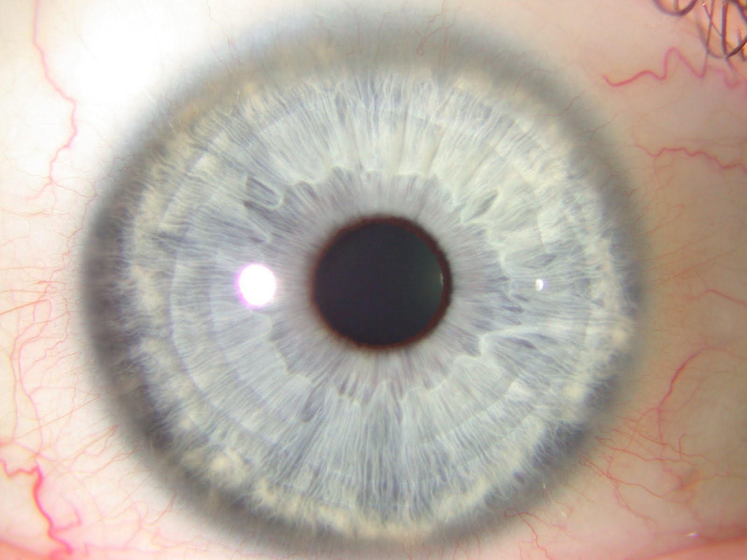
Silk Linen Iris

Slide 37
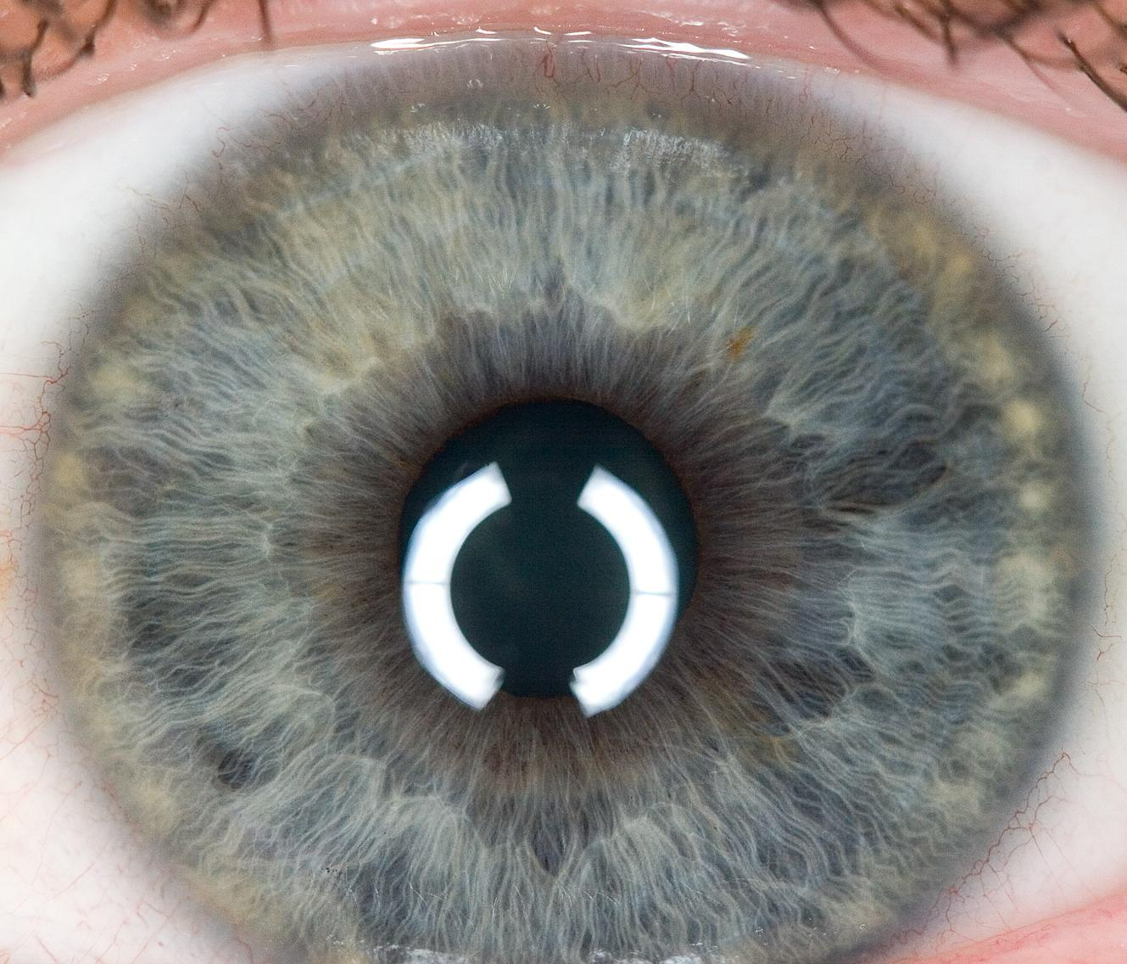
THE INTESTINAL RING
LINEN IRIS

Slide 38
Linen Iris

Slide 39
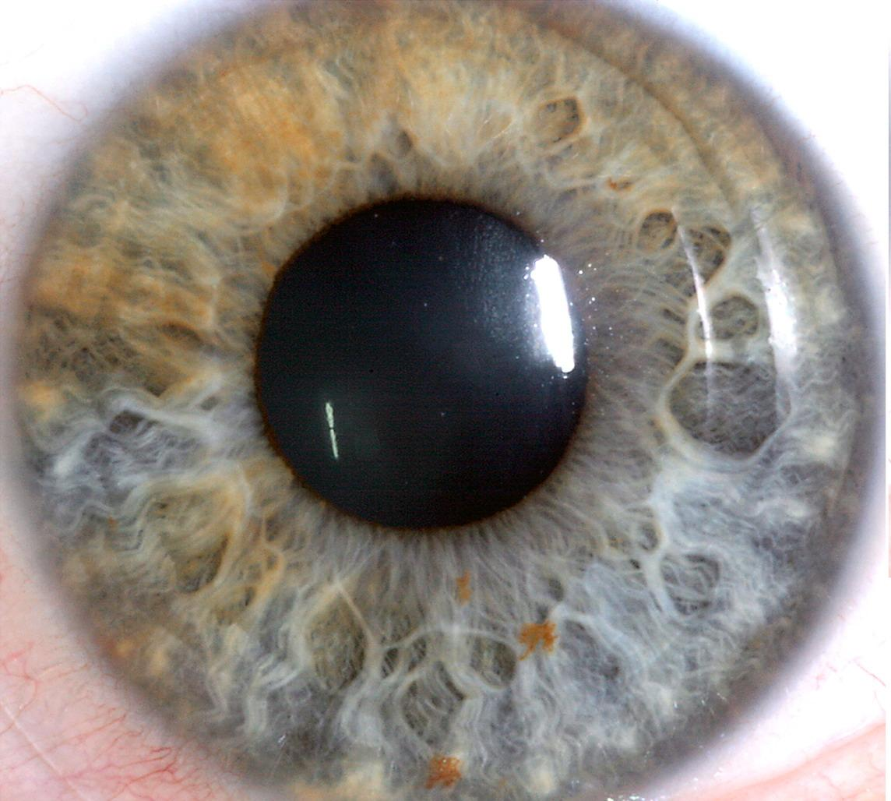
HESSIAN IRIS
Hessian Iris

Slide 40
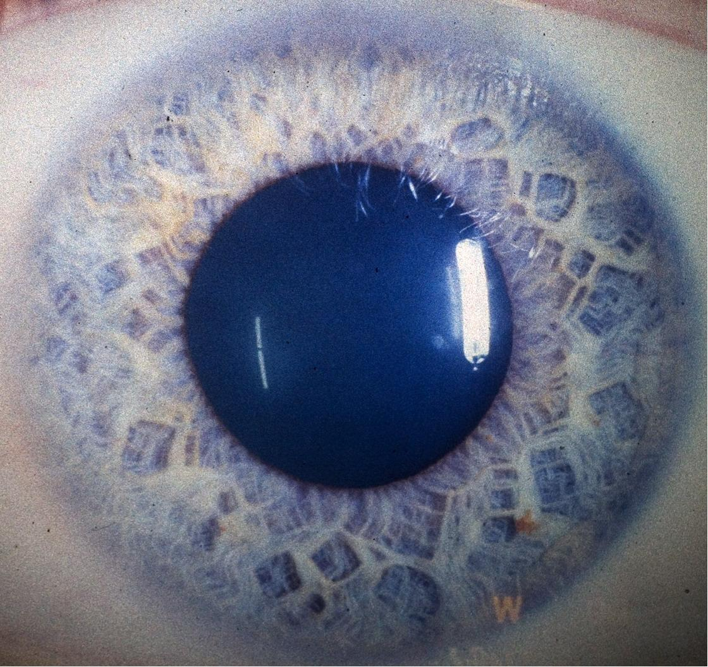
HESSIAN IRIS
Hessian Iris

Slide 41
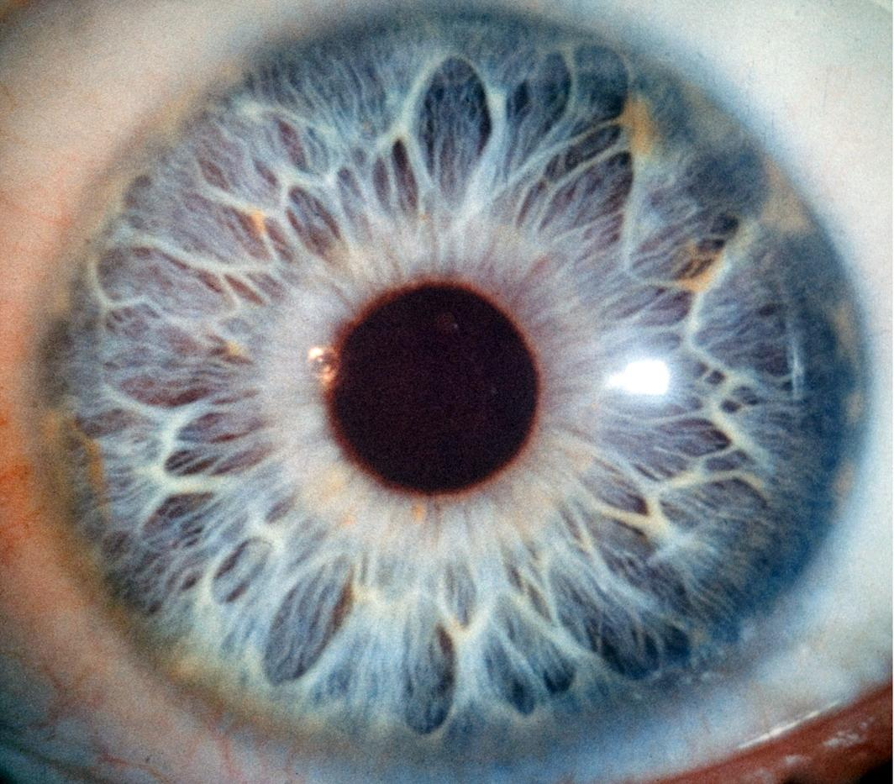
NET IRIS
Net Iris

Slide 42
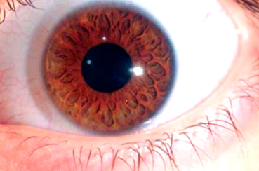
Net Iris

Slide 43
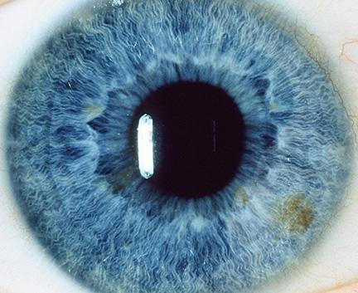
Pure Lymphatic Constitution

Slide 44
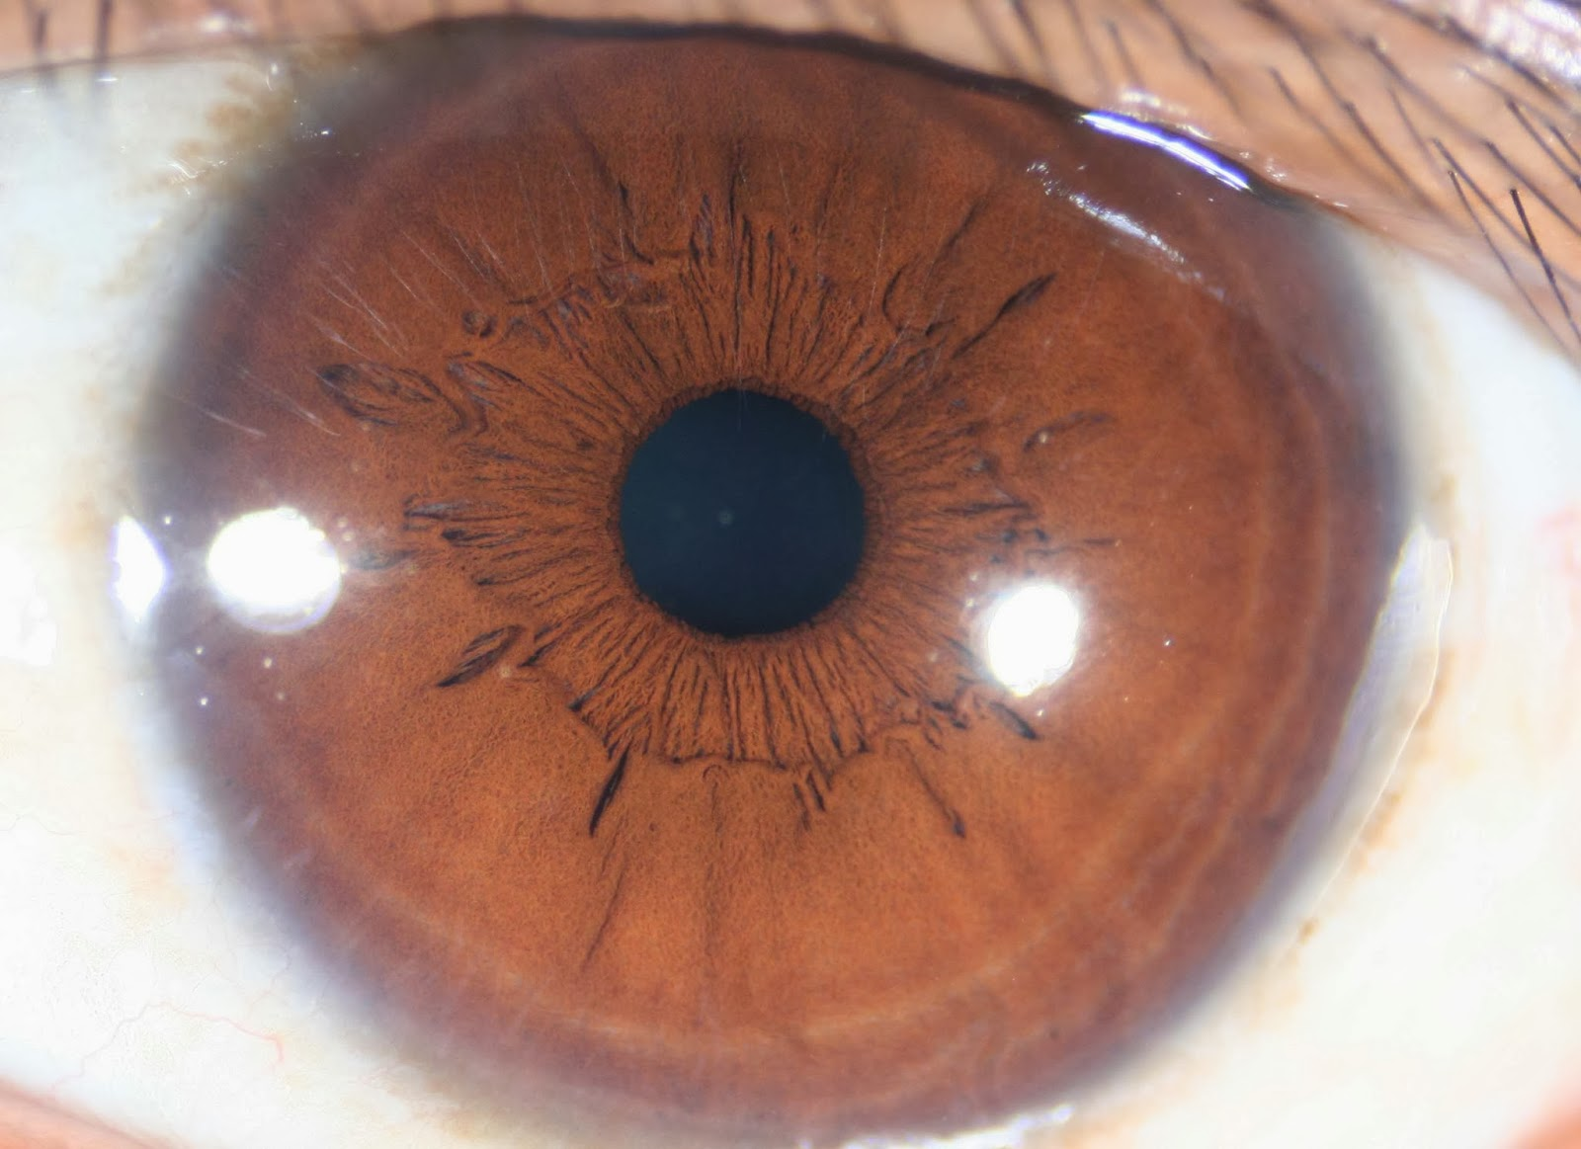
Haematogenic Constitution

Slide 45
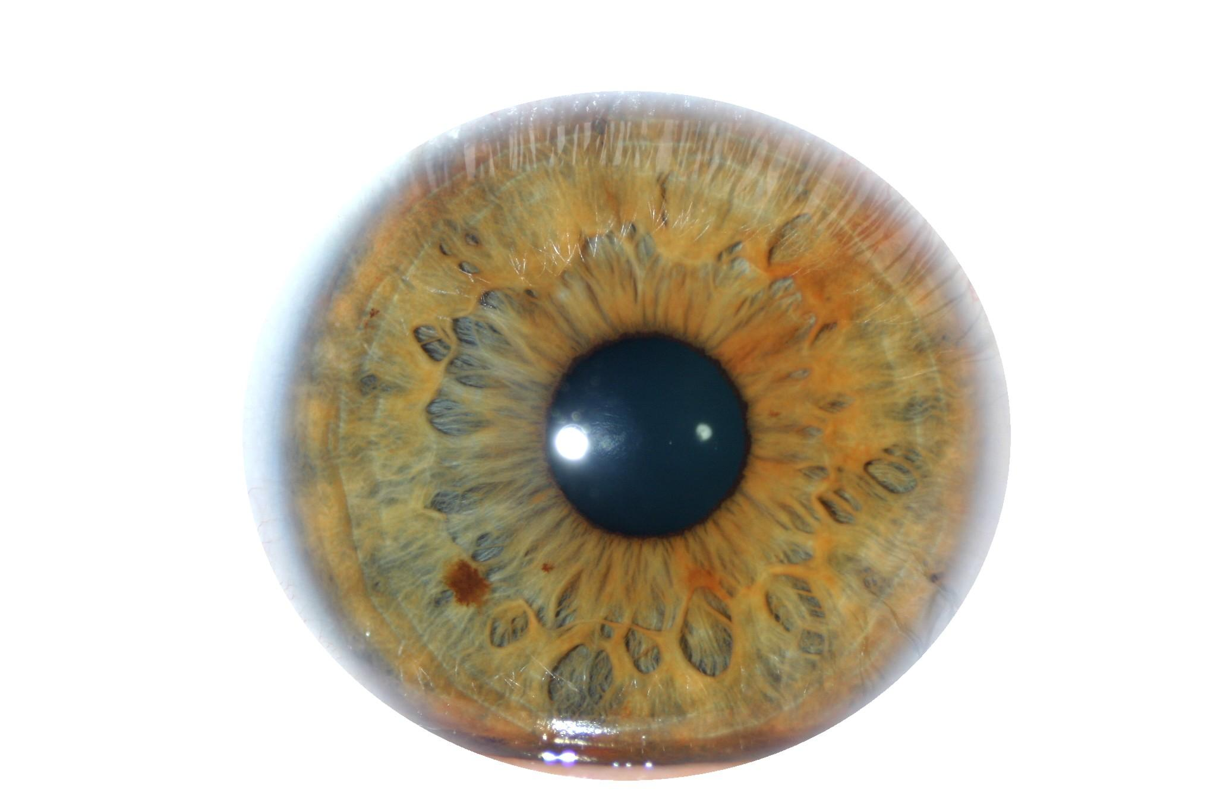
Mixed Biliary Constitution

Slide 46
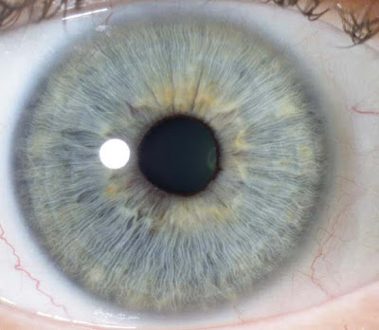
Neurogenic Constitution

Slide 47
Neuro Lymphatic sub Constitution

Slide 48
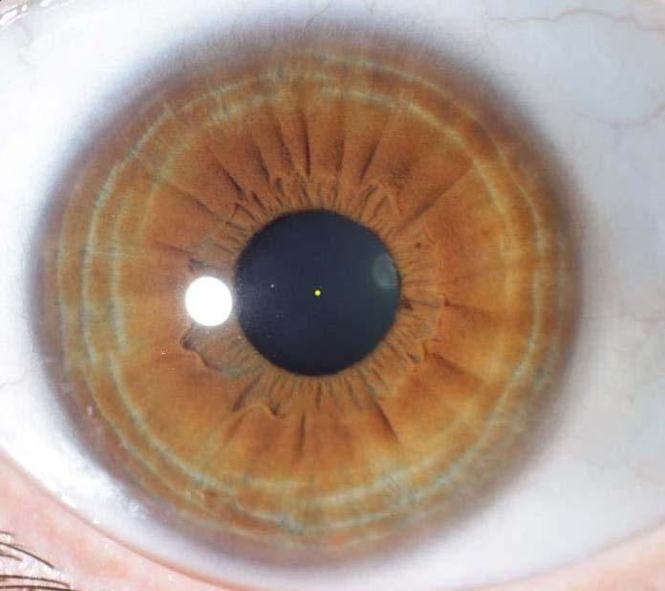
Anxiety Tetanic Constitution

Slide 49
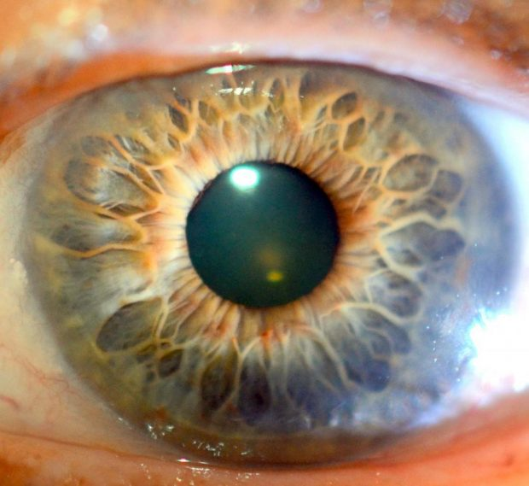
Glandular Constitution

Slide 50
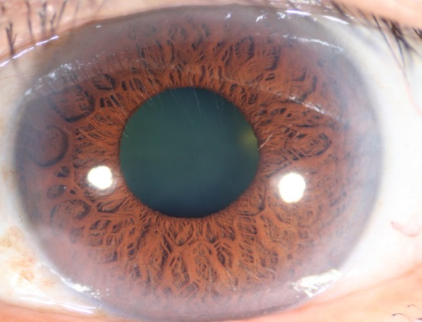
Weak Connective Tissue Constitution

Slide 51
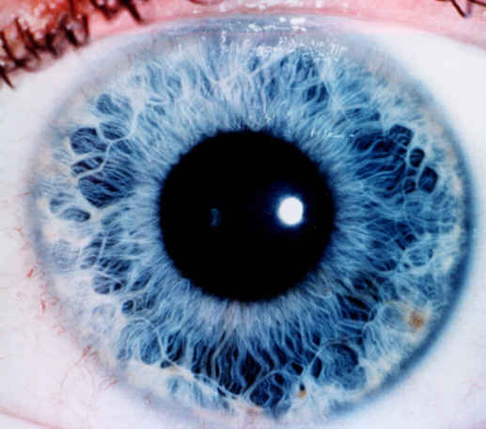
Cardio Abdominal Constitution

Slide 52
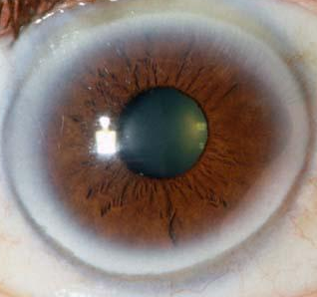
Lipaemic Constitution

Slide 53
Hydrogenoid Constitution

Slide 54
Pancreatic Constitution

Slide 55
Uric Acid Constitution

Slide 56
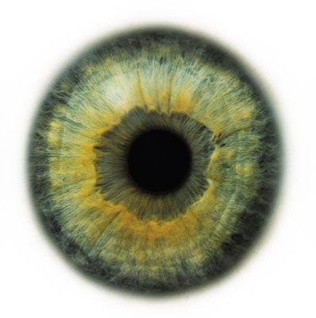
Kidney Lymphatic Constitution

Slide 57
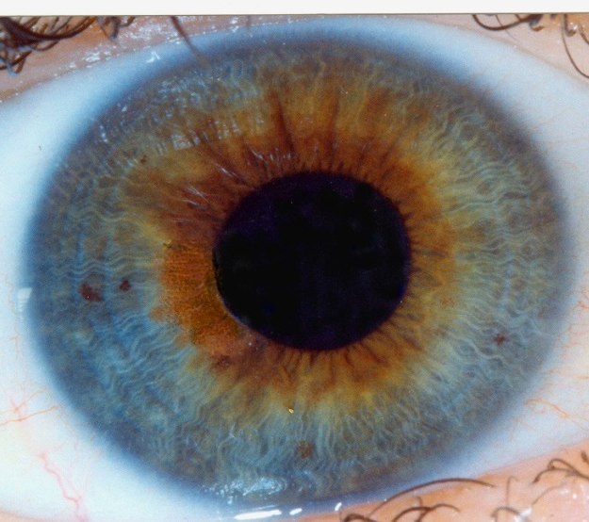
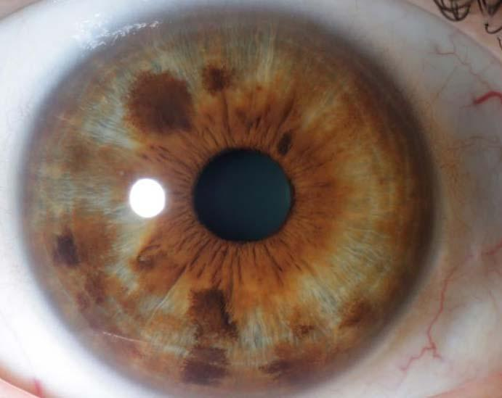
Dyscratic Constitution

Slide 58
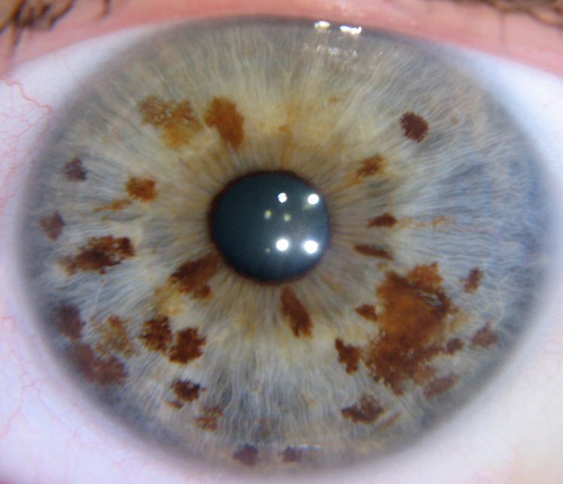
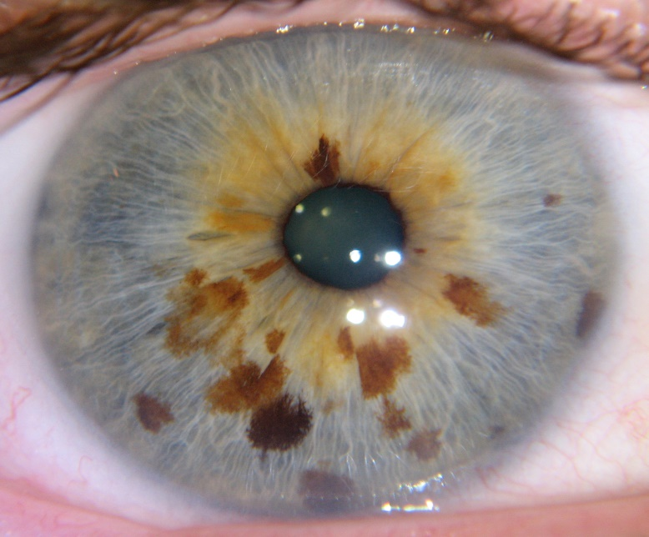
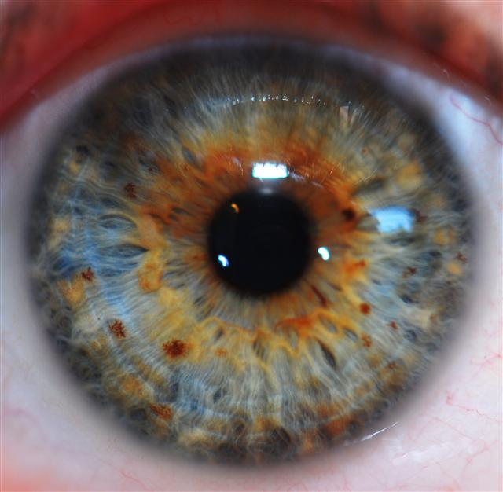
Miasmic Constitution

Slide 59
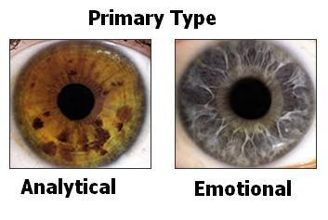
Behavioural Iridology

Slide 60
http://www.iriscope.org/iridology-history-2.htm

Slide 61
Behavioural Iridology
Empathetic
Driver/Motivator

Slide 62
Analytical type
Presence of Psoric or pigment spots

Slide 63
Emotional Type
Lacunae

Slide 64
Empathetic Type
Neurogenic fibres

Slide 65
Driver/Motivator “Shaker”
Lacunae and pigment spots

Slide 66
4 Behavioural Types

Slide 67
Tubercular Miasm, Koch’s Sign

Slide 68
Psora Miasm
Scurf rim and Psoric spots

Slide 69
Syphilitic miasm
White overlay and white Collarette

Slide 70
Sycotic miasm
Loose fibres, weak connective tissue,

Slide 71
Sycosis Miasm (after Bradbury)

Slide 72
TB Miasm
Shadow or Lacuna over right lung
Floating autonomic nerve wreath
Lymphatic tophi
Thread or thread net across the pupil
Dilated pupil
Psora and Syphilis Miasm combined

Slide 73
TB Miasm (Syphilis and Psora)

Slide 74
Inner Pupillary Border

Slide 76
Time Risk: break in collerette

Slide 77
Essay question

